Slide 1
Global Family Success Program A Generations Empowerment Enterprises, LLC Program

Slide 2
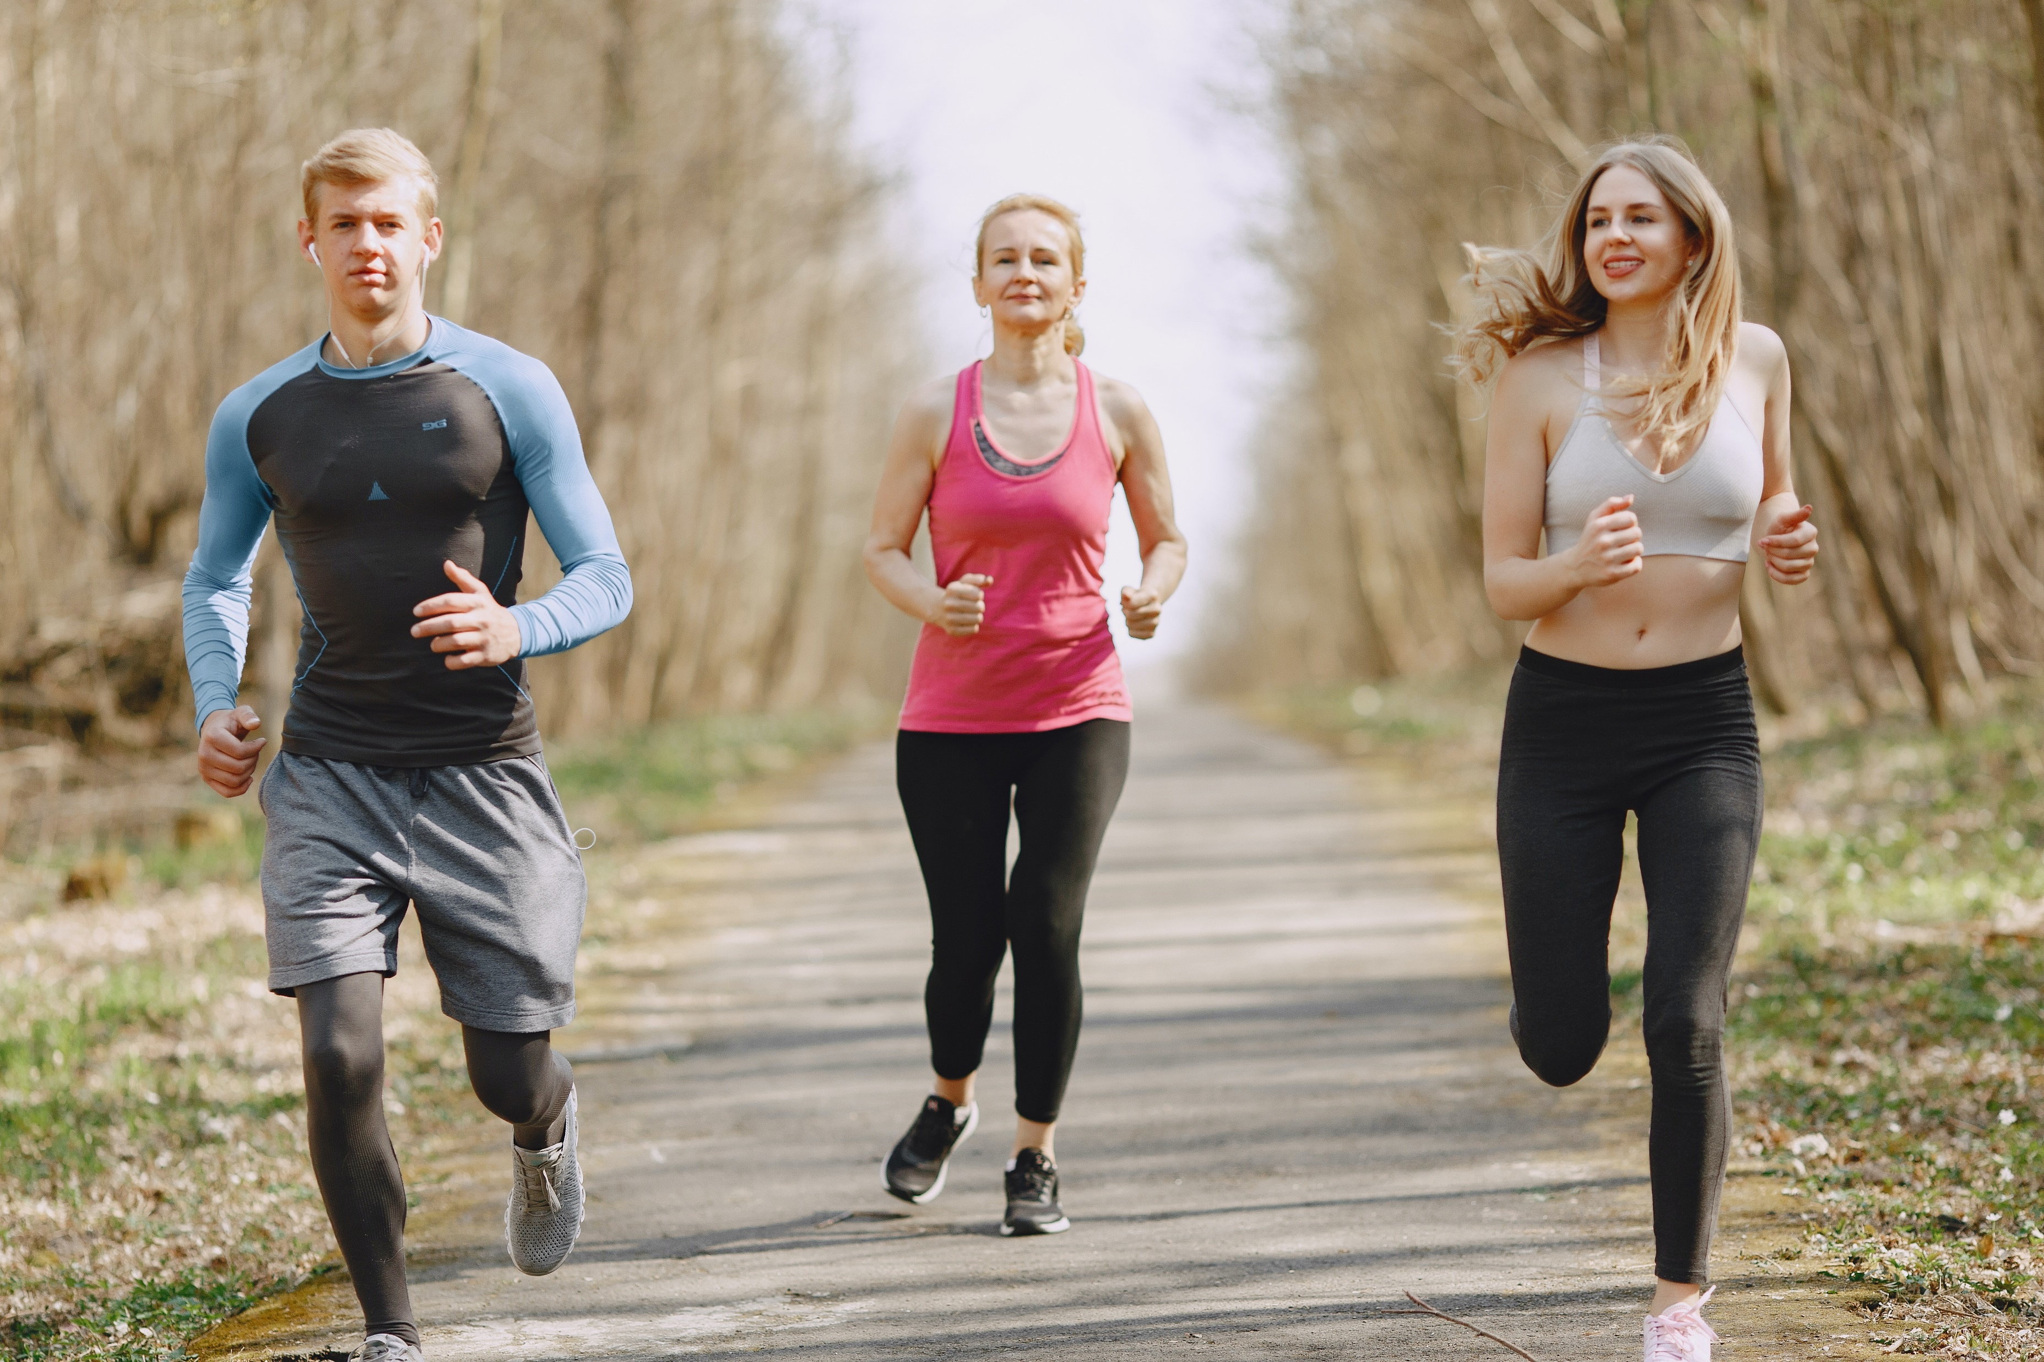
Build Good Family Physical Health. Live Your Dream. Families Learning Together Build Generational Wealth

Slide 3
Welcome To
GFS 300
Build Good Family Physical Health
© 2020 Copyright by Generations Empowerment Enterprises, LLC
Notes:
Both Phillip & Janicr

Slide 4
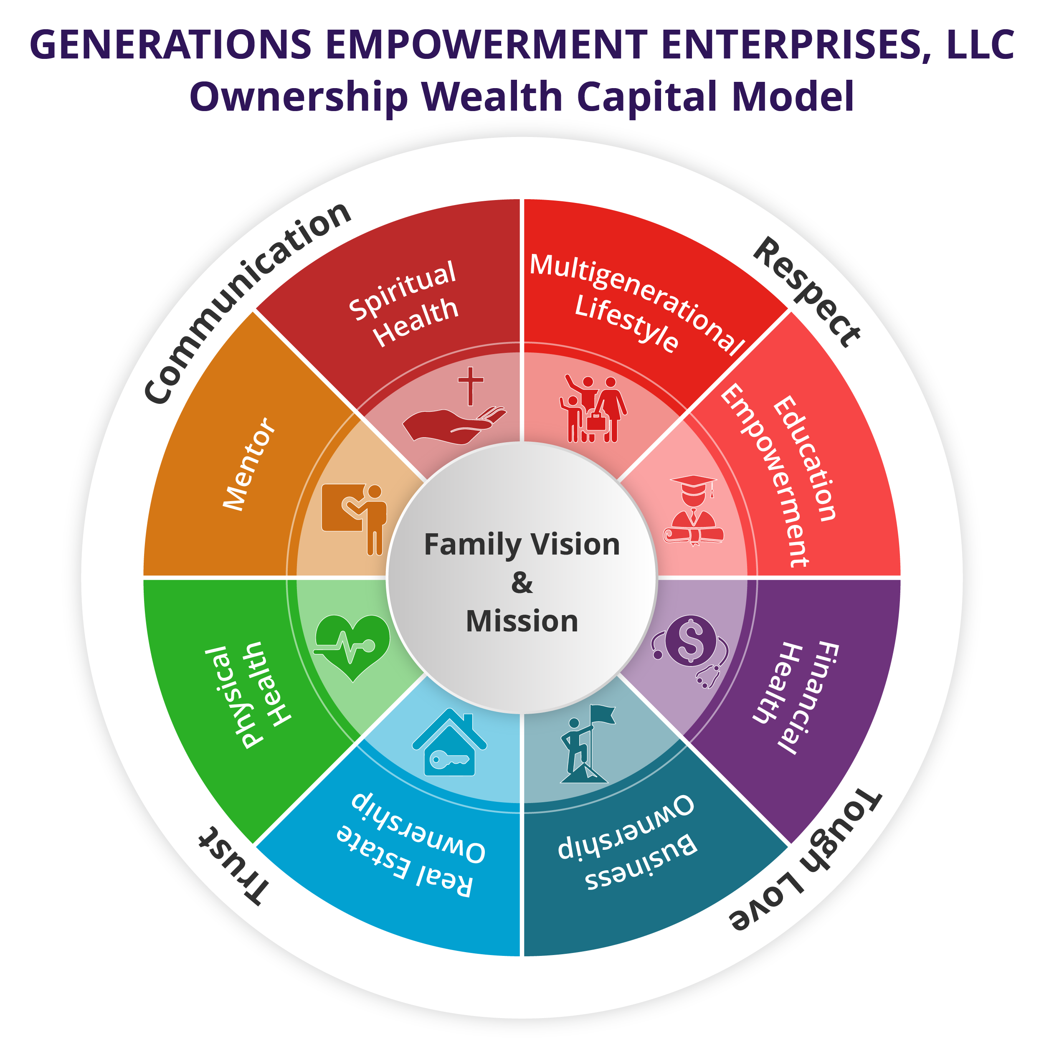
GFS 300
Build Good Family Physical Health
Chapter 17:
Financial Health & Wealth
Financial Health 
© 2020 Copyright by Generations Empowerment Enterprises, LLC
Notes:
Phillip
This is a picture of the comprehensive Generational Wealth Capital Model covered in the Family Vision Success Workshop Series Objectives
Family Legacy Capital Model: This is model that will keep your family together for generations.
Ownership Wealth Capital Model: This is model will allow your family to build wealth through ownership (Business Ownership, Financial Ownership, Real Estate Ownership, Education Ownership, Physical Health Ownership and Spiritual Health Ownership)
GOLDEN KEY: You must have both working together to create generational wealth.
No matter your individual or family vision or purpose must include more than one of attributes represented by these models.
Part 1: Family Vision Foundation 101 covers the majority of areas listed on the left side of our Model titled: Family Legacy Capital Model

Slide 5
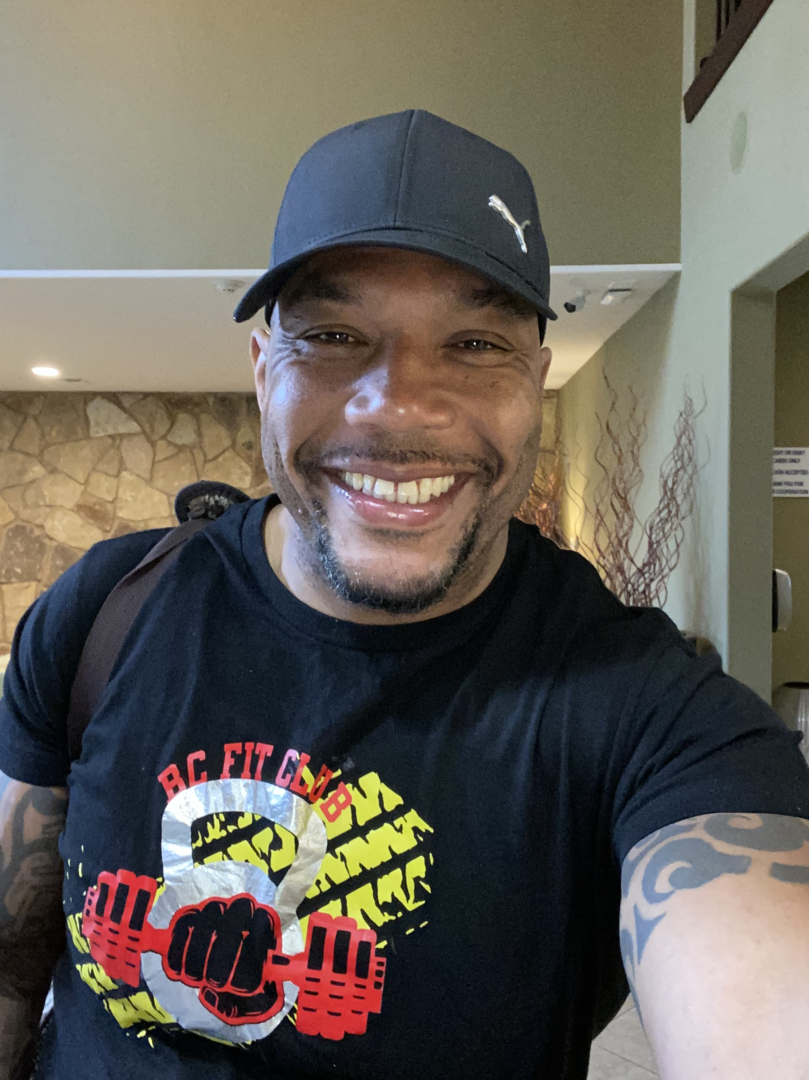
Ben Carter Founder & Owner BC Fit Club
Certified Personal Fitness Trainer
Boot Camp & Performance Trainer
Private At Home Virtual Trainer
© 2020 Copyright by Generations Empowerment Enterprises, LLC
Notes:
Phillip

Slide 6
Chapter 22
Physical Health
© 2020 Copyright by Generations Empowerment Enterprises, LLC
Notes:
Janice

Slide 7
Chapter 22: Physical Health
“I have already believed that exercise is the key not only to physical health but to peace of mind.”
By Nelson Mandela
© 2020 Copyright by Generations Empowerment Enterprises, LLC
Notes:
Janice – Explain Parking Lot
Pause to allow time for the Family Vision Poll – use small white piece of paper – Everyone participate
Questions: If you have a question, raise your hand. We welcome questions anytime. Or put on the Parking Lot.
Explain the Parking Lot – purpose
Pause NOW to give everyone a few minutes to complete their POLL – Everyone will need a small piece of the white pre-cut paper. Here's the questions:
Do you have a Written Family Vision? Answer only YES or NO - We do NOT need your names. This is for a later activity. THANK YOU!
Allow time for participants to complete the Family Vision Poll & Collect Now!!!
Note: During this workshop you will learn both the “DO’s and DONT’s” associated with family success. The don’ts are just as important as the do’s.

Slide 8
Chapter 22: Physical Health
Objectives:
WKB p.127
Learn the benefits of good exercise plan for your family
Learn the tips to a good weight loose program
© 2020 Copyright by Generations Empowerment Enterprises, LLC
Notes:
Janice

Slide 9
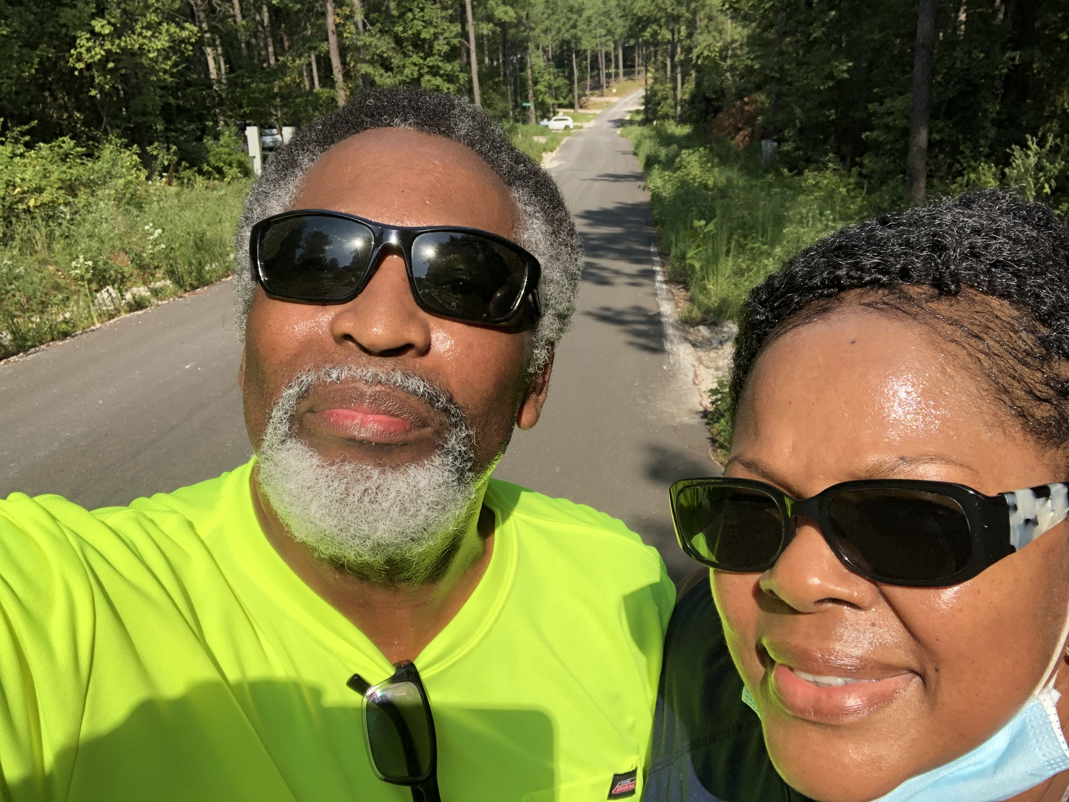
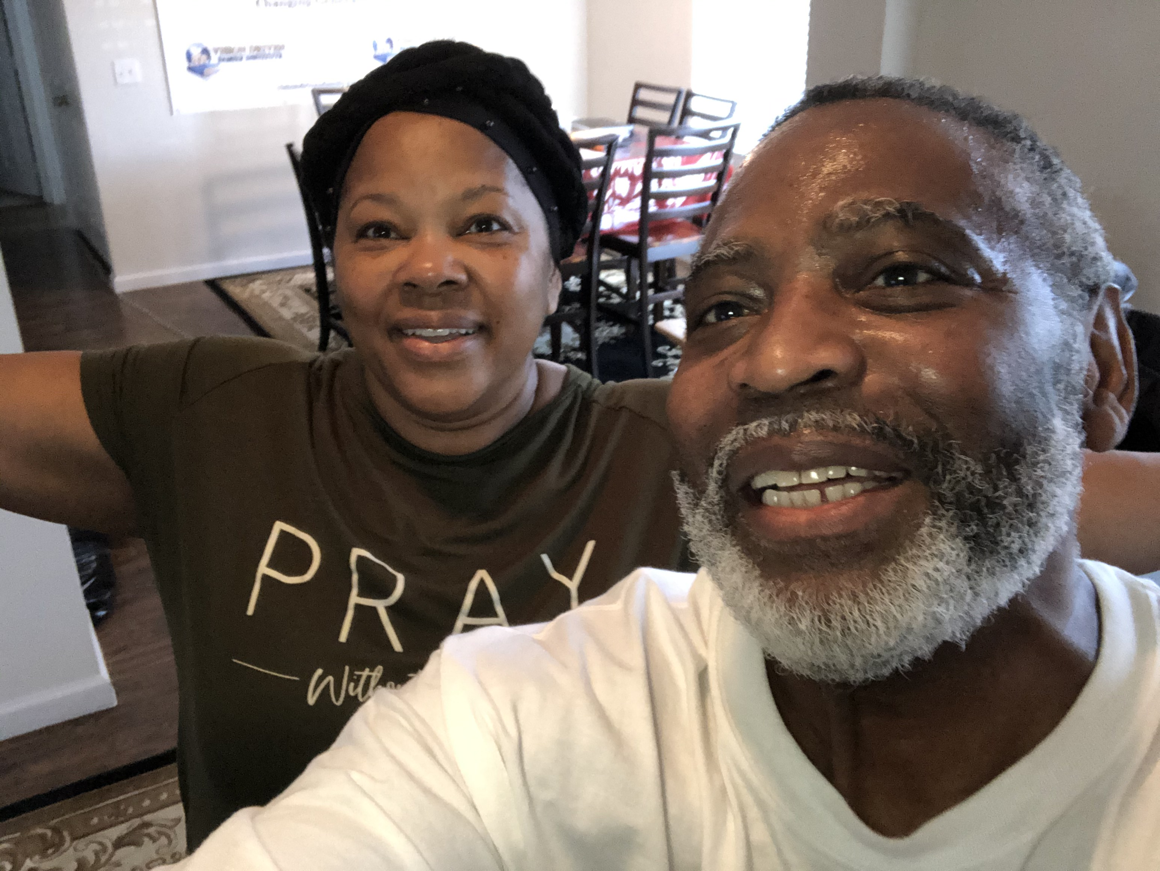
Phillip & Janice Personal Fitness/Health Tips Families Learning Together Build Generational Wealth

Slide 10
Chapter 22: Physical Health
Tips
Make A Fitness/Health Lifestyle Change Decision (Household)
Established A Home Environment For Success
Greatly Reduced/Eliminated Certain Foods/Snacks: Cakes, Pies, Chips, Pop, etc.
Greatly Increase Water Intake
Invested In A Fitbit, Dumbbells, Bands, etc.
Invested In Private At Home Personal Fitness Trainer
Set workout times (flexible)
© 2020 Copyright by Generations Empowerment Enterprises, LLC
Notes:
Janice

Slide 11
Chapter 22: Physical Health
Tips
Exercise Together (Own Pace)
Accountability Partner
Set Fitness Goals
Recognized & Awarded Goals Achieved
© 2020 Copyright by Generations Empowerment Enterprises, LLC
Notes:
Janice

Slide 12
Benefits of a Good Family Exercise Plan Families Learning Together Build Generational Wealth

Slide 13
Chapter 22: Physical Health
Benefits of a Good Family Exercise Plan:
Help you control your weight
Reduce your risk of heart diseases
Help your body manage blood sugar and insulin levels
Help you quit smoking
Important Note: Consult with your doctor before starting your exercise program
© 2020 Copyright by Generations Empowerment Enterprises, LLC
Notes:
Janice

Slide 14
Chapter 22: Physical Health
Benefits of a Good Family Exercise Plan:
Improve your mental health and mood
Help keep your thinking, learning, and judgment skills sharp as you age
Strengthen your bones and muscles
Reduce your risk of some cancers
Important Note: Consult with your doctor before starting your exercise program
© 2020 Copyright by Generations Empowerment Enterprises, LLC
Notes:
Janice

Slide 15
Chapter 22: Physical Health
Benefits of a Good Family Exercise Plan:
Reduce your risk of falls
Improve your sleep
Improve your sexual health
Increase your chances of living longer
Important Note: Consult with your doctor before starting your exercise program
© 2020 Copyright by Generations Empowerment Enterprises, LLC
Notes:
Janice

Slide 16
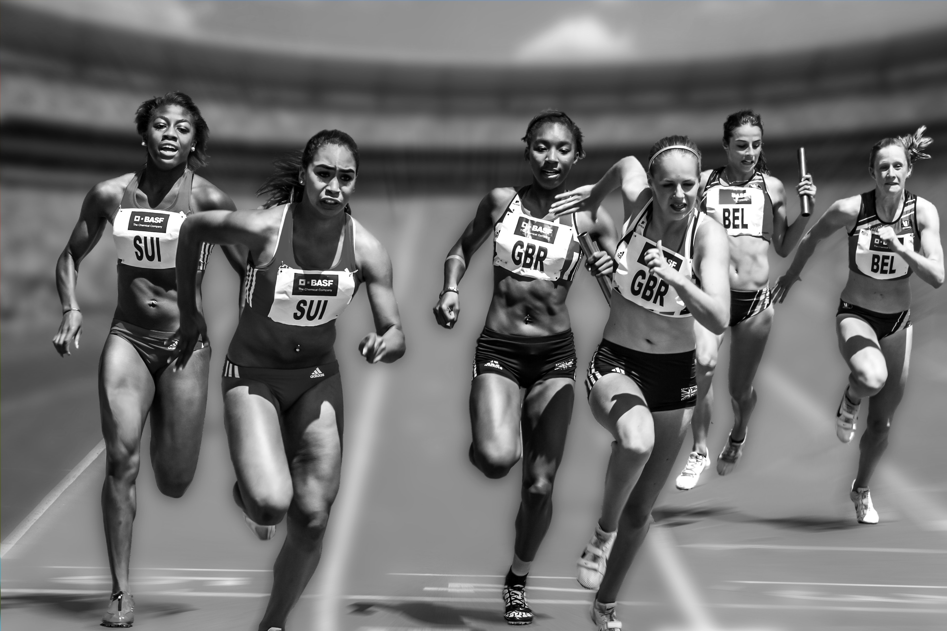
Interested In Loosing Weight Families Learning Together Build Generational Wealth

Slide 17
Chapter 22: Physical Health
Interested In Loosing Weight
Reference: Nutrition.gov (https://www.nutrition.gov/topics/healthy-living-and-weight/strategies-success/interested-losing-weight)
Note: Weight loss can be achieved either by eating fewer calories or by burning more calories with physical activity, preferably both.
A healthy weight loss program consists of:
A reasonable, realistic weight loss goal
A reduced calorie, nutritionally-balanced eating plan
Regular physical activity
A behavior change plan to help you stay on track with your goals
© 2020 Copyright by Generations Empowerment Enterprises, LLC
Notes:
Janice

Slide 18
Chapter 22: Physical Health
Interested In Loosing Weight
Reference: Nutrition.gov (https://www.nutrition.gov/topics/healthy-living-and-weight/strategies-success/interested-losing-weight)
Keep in Mind
Calories count
Portions count
Nutrition counts
Even a small amount of weight loss can lead to big health benefits
Strive to develop good habits to last a lifetime
Discuss weight loss with your doctor before getting started
© 2020 Copyright by Generations Empowerment Enterprises, LLC
Notes:
Janice

Slide 19
Chapter 22: Physical Health
Interested In Loosing Weight
Reference: Nutrition.gov (https://www.nutrition.gov/topics/healthy-living-and-weight/strategies-success/interested-losing-weight)
Getting Started
Check your Body Mass Index (BMI) - an indicator of body fat - and see where it fits within the BMI categories.
Discuss weight loss with your doctor and decide on a goal. If you have a lot of weight to lose, set a realistic intermediate goal, maybe to lose 10 pounds. Remember that even a small amount of weight loss can lead to big health benefits.
© 2020 Copyright by Generations Empowerment Enterprises, LLC
Notes:
Janice

Slide 20
Chapter 22: Physical Health
Interested In Loosing Weight
Reference: Nutrition.gov (https://www.nutrition.gov/topics/healthy-living-and-weight/strategies-success/interested-losing-weight)
Key Behaviors of Successful Losers*
Getting regular physical activity
Reducing calorie and fat intake
Eating regular meals, including breakfast
Weighing themselves regularly
Not letting small "slips" turn into large weight regain
*From The National Weight Control Registry. See "Long-term Weight Maintenance" in American Journal of Clinical Nutrition, Vol. 82, No. 1, 222S-225S, July 2005.
© 2020 Copyright by Generations Empowerment Enterprises, LLC
Notes:
Janice

Slide 21
Chapter 22: Physical Health
Interested In Loosing Weight
Reference: Nutrition.gov (https://www.nutrition.gov/topics/healthy-living-and-weight/strategies-success/interested-losing-weight)
© 2020 Copyright by Generations Empowerment Enterprises, LLC
Notes:
Janice

Slide 22
Chapter 22: Physical Health
Assignment
WKB p.128
© 2020 Copyright by Generations Empowerment Enterprises, LLC
Notes:
Janice

Slide 23
Q & A
This Photo by Unknown author is licensed under CC BY-NC.
© 2020 Copyright by Generations Empowerment Enterprises, LLC
Notes:
1:45 pm - Both

Slide 24
GFS 300
Build Good Family Physical Health
Chapter 17:
Financial Health & Wealth
Financial Health 
© 2020 Copyright by Generations Empowerment Enterprises, LLC
Notes:
Phillip
This is a picture of the comprehensive Generational Wealth Capital Model covered in the Family Vision Success Workshop Series Objectives
Family Legacy Capital Model: This is model that will keep your family together for generations.
Ownership Wealth Capital Model: This is model will allow your family to build wealth through ownership (Business Ownership, Financial Ownership, Real Estate Ownership, Education Ownership, Physical Health Ownership and Spiritual Health Ownership)
GOLDEN KEY: You must have both working together to create generational wealth.
No matter your individual or family vision or purpose must include more than one of attributes represented by these models.
Part 1: Family Vision Foundation 101 covers the majority of areas listed on the left side of our Model titled: Family Legacy Capital Model

Slide 25
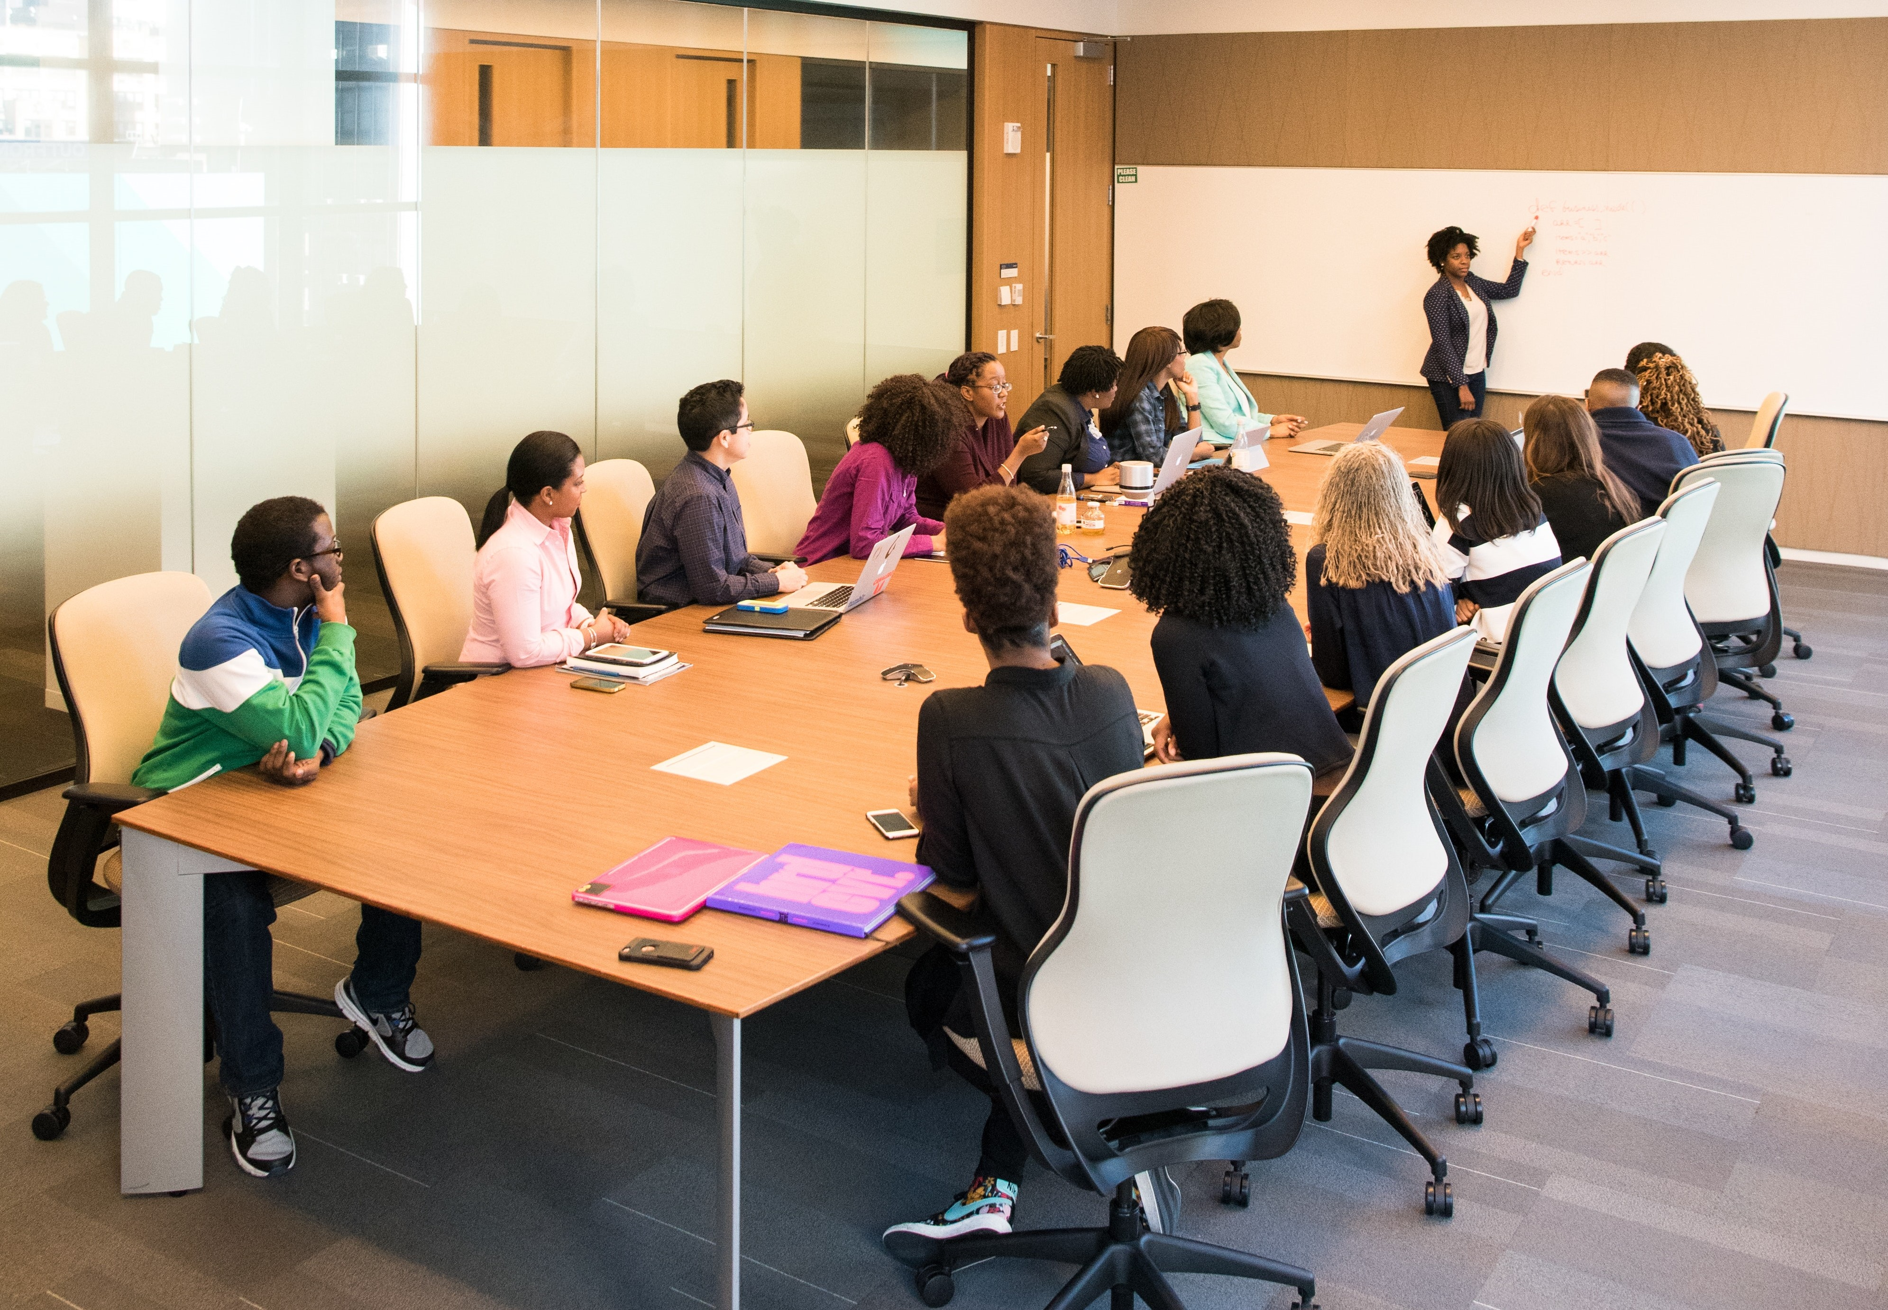
Family Empowerment Services
Family Success
Webinars
Family Private Weekend Retreats
Group Webinars & Workshops
Coaching
Services
© 2020 Copyright by Generations Empowerment Enterprises, LLC
Notes:
Phillip or Janice

Slide 26
Contact
Email: admin@globalfamilysuccess.com
Website: https://globalfamilysuccess.com
Facebook: https://www.facebook.com/GenerationsEmpowermentEnterprisesLLC
© 2020 Copyright by Generations Empowerment Enterprises, LLC
Notes:
Phillip or Janice

Slide 27
Global Family Success Program A Generations Empowerment Enterprises, LLC Program

