Slide 1
Generations Empowerment Enterprises, LLC Families Learning Together Builds Generational Wealth

Slide 2
Chapter 20
Business Ownership
© 2020 Copyright by Generations Empowerment Enterprises, LLC
Notes:
Janice

Slide 3
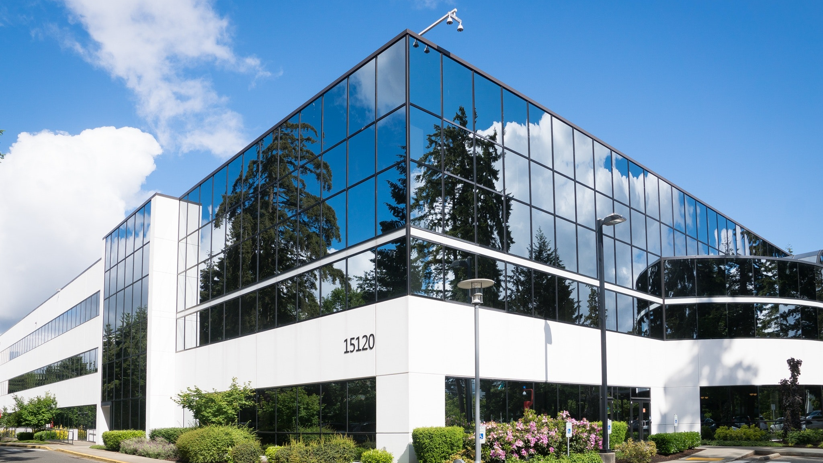
Build Wealth Through Business Ownership Families Learning Together Builds Generational Wealth

Slide 4
Chapter 20: Business Ownership
“Our nation faces significant challenges in seeking to address the growing racial wealth gap. Among the potential solutions to this gap, there are reasons to be optimistic that we can expand the role that business ownership plays in building wealth for people of color. Relatively low levels of business assets held by Latinos and African Americans are one of the reasons that they hold lower levels of wealth overall.”
Bridging the Divide: How Business Ownership Can Help Close the Racial Wealth Gap
Joyce Klein, Director of FIELD at the Institute
January 23, 2017
© 2020 Copyright by Generations Empowerment Enterprises, LLC
Notes:
Janice – Explain Parking Lot
Pause to allow time for the Family Vision Poll – use small white piece of paper – Everyone participate
Questions: If you have a question, raise your hand. We welcome questions anytime. Or put on the Parking Lot.
Explain the Parking Lot – purpose
Pause NOW to give everyone a few minutes to complete their POLL – Everyone will need a small piece of the white pre-cut paper. Here's the questions:
Do you have a Written Family Vision? Answer only YES or NO - We do NOT need your names. This is for a later activity. THANK YOU!
Allow time for participants to complete the Family Vision Poll & Collect Now!!!
Note: During this workshop you will learn both the “DO’s and DONT’s” associated with family success. The don’ts are just as important as the do’s.

Slide 5
Chapter 20: Business Ownership
“Entrepreneurship is living a few years of your life like most people won’t, so that you can spend the rest of our life like most people can’t.”
By Unknown
© 2020 Copyright by Generations Empowerment Enterprises, LLC
Notes:
Janice – Explain Parking Lot
Pause to allow time for the Family Vision Poll – use small white piece of paper – Everyone participate
Questions: If you have a question, raise your hand. We welcome questions anytime. Or put on the Parking Lot.
Explain the Parking Lot – purpose
Pause NOW to give everyone a few minutes to complete their POLL – Everyone will need a small piece of the white pre-cut paper. Here's the questions:
Do you have a Written Family Vision? Answer only YES or NO - We do NOT need your names. This is for a later activity. THANK YOU!
Allow time for participants to complete the Family Vision Poll & Collect Now!!!
Note: During this workshop you will learn both the “DO’s and DONT’s” associated with family success. The don’ts are just as important as the do’s.

Slide 6
Chapter 20: Business Ownership
Objectives:
Learn the benefits of owning a successful family business
Learn the attributes of a successful family business
© 2020 Copyright by Generations Empowerment Enterprises, LLC
Notes:
Janice

Slide 7
Benefits of a Owning a Successful Family Business Families Learning Together Build Generational Wealth

Slide 8
Chapter 20: Business Ownership
Benefits of Owning a Successful Family Business:
Acronym “FLIP”
F = Financial Reward: Building a successful family business is very challenging and risky. However, the results of running your own business gives the family a chance to make more money collectively than they could individually if they were employed by someone else. Long-term your family can benefit greatly from all their hard work.
© 2020 Copyright by Generations Empowerment Enterprises, LLC
Notes:
Janice

Slide 9
Chapter 20: Business Ownership
Benefits of a Successful Family Business:
Acronym “FLIP”
L = Learning Opportunities: As an owner of a family business, family members from multiple generations can be involved in all aspects of the family business. This situation creates numerous opportunities to gain a thorough understanding of the various business functions from sales, customer service, administration, marketing and more. Because multiple generations are involved, passing the business to the next generation can be smoother.
© 2020 Copyright by Generations Empowerment Enterprises, LLC
Notes:
Janice

Slide 10
Chapter 20: Business Ownership
Benefits of a Successful Family Business:
Acronym “FLIP”
I = Independence: As an owner of a successful family business, you’re your own boss. You can hire the people you want including qualified family members. You do not have to obtain permission to take a vacation day. You can’t get fired. More importantly, you have the freedom to make the decisions that are crucial to your own business success.
© 2020 Copyright by Generations Empowerment Enterprises, LLC
Notes:
Janice

Slide 11
Chapter 20: Business Ownership
Benefits of a Successful Family Business:
Acronym “FLIP”
P = Personal Satisfaction: As an owner of a successful family business, you can select and determine the industry that you really enjoy. You’ll be able to put the skills and knowledge of your family to use, and you’ll gain personal satisfaction from implementing your ideas, working directly with customers, and watching your business succeed.
© 2020 Copyright by Generations Empowerment Enterprises, LLC
Notes:
Janice

Slide 12
Chapter 20: Business Ownership
Assignment
WKB p.123
© 2020 Copyright by Generations Empowerment Enterprises, LLC
Notes:
Janice

Slide 13
Generations Empowerment Enterprises, LLC Families Learning Together Builds Generational Wealth

