Slide 1
Global Family Success Program A Generations Empowerment Enterprises, LLC Program

Slide 2
Family Vision Reward System
Families Learning Together Build Generational Wealth

Slide 3
Chapter 14
Family Vision Reward System
© 2020 Copyright by Generations Empowerment Enterprises, LLC
Notes:
Janice

Slide 4
Chapter 14: Family Vision Rewards System
"People work for money but go the extra mile for recognition, praise and rewards."
By Dale Carnegie, Leadership Training Guru
© 2020 Copyright by Generations Empowerment Enterprises, LLC
Notes:
Janice – Explain Parking Lot
Pause to allow time for the Family Vision Poll – use small white piece of paper – Everyone participate
Questions: If you have a question, raise your hand. We welcome questions anytime. Or put on the Parking Lot.
Explain the Parking Lot – purpose
Pause NOW to give everyone a few minutes to complete their POLL – Everyone will need a small piece of the white pre-cut paper. Here's the questions:
Do you have a Written Family Vision? Answer only YES or NO - We do NOT need your names. This is for a later activity. THANK YOU!
Allow time for participants to complete the Family Vision Poll & Collect Now!!!
Note: During this workshop you will learn both the “DO’s and DONT’s” associated with family success. The don’ts are just as important as the do’s.

Slide 5
Chapter 14: Family Vision Rewards System
Employee Recognition Program
According to a survey by World at Work, an organization of human resource professionals, nearly 90% of their member’s employers offer some type of formal recognition program. (This is from a survey of more than 5,000 companies)
Reference: Article: Vast majority of employers have employee recognition programs. By Jack Craver dated June 12, 2017; Go to https://www.benefitspro.com/2017/06/12/vast-majority-of-employers-have-employee-recogniti
© 2020 Copyright by Generations Empowerment Enterprises, LLC
Notes:
Janice

Slide 6
Chapter 14: Family Vision Rewards System
Objectives:
WKB p.82
Learn the benefits of an effective family rewards program
Learn the best time to host a family rewards ceremony
© 2020 Copyright by Generations Empowerment Enterprises, LLC
Notes:
Janice

Slide 7
Family Vision Rewards Program Benefits
Families Learning Together Build Generational Wealth

Slide 8
Chapter 14: Family Vision Rewards System
Family Vision Rewards Program Benefits:
Increase the number of family members actively involved in attaining the family vision.
Motivate the entire family to work together to achieve their family vision and mission.
Boost the family morale by communicating to individual members how valuable they are to help accomplish the family vision.
© 2020 Copyright by Generations Empowerment Enterprises, LLC
Notes:
Janice

Slide 9
Chapter 14: Family Vision Rewards System
Family Vision Rewards Program Benefits:
Praise and appreciate family members that have accomplished specific tasks which supported the family vision.
Establish an environment that allows the family leaders/elders to provide positive feedback to individual family members.
Increase individual productivity by reinforcing positive behavior that supports the family’s vision and mission.
© 2020 Copyright by Generations Empowerment Enterprises, LLC
Notes:
Janice

Slide 10
Recommended Time To Host Your Rewards Program
Families Learning Together Build Generational Wealth

Slide 11
Chapter 14: Family Vision Rewards System
Recommended Time to Host Your Rewards Program:
Family Reunions
Family Holiday Events
Family Celebrations, examples: 50th wedding anniversary
Family Vacations/Cruises, etc.
Anytime the entire family is together
© 2020 Copyright by Generations Empowerment Enterprises, LLC
Notes:
Janice

Slide 12
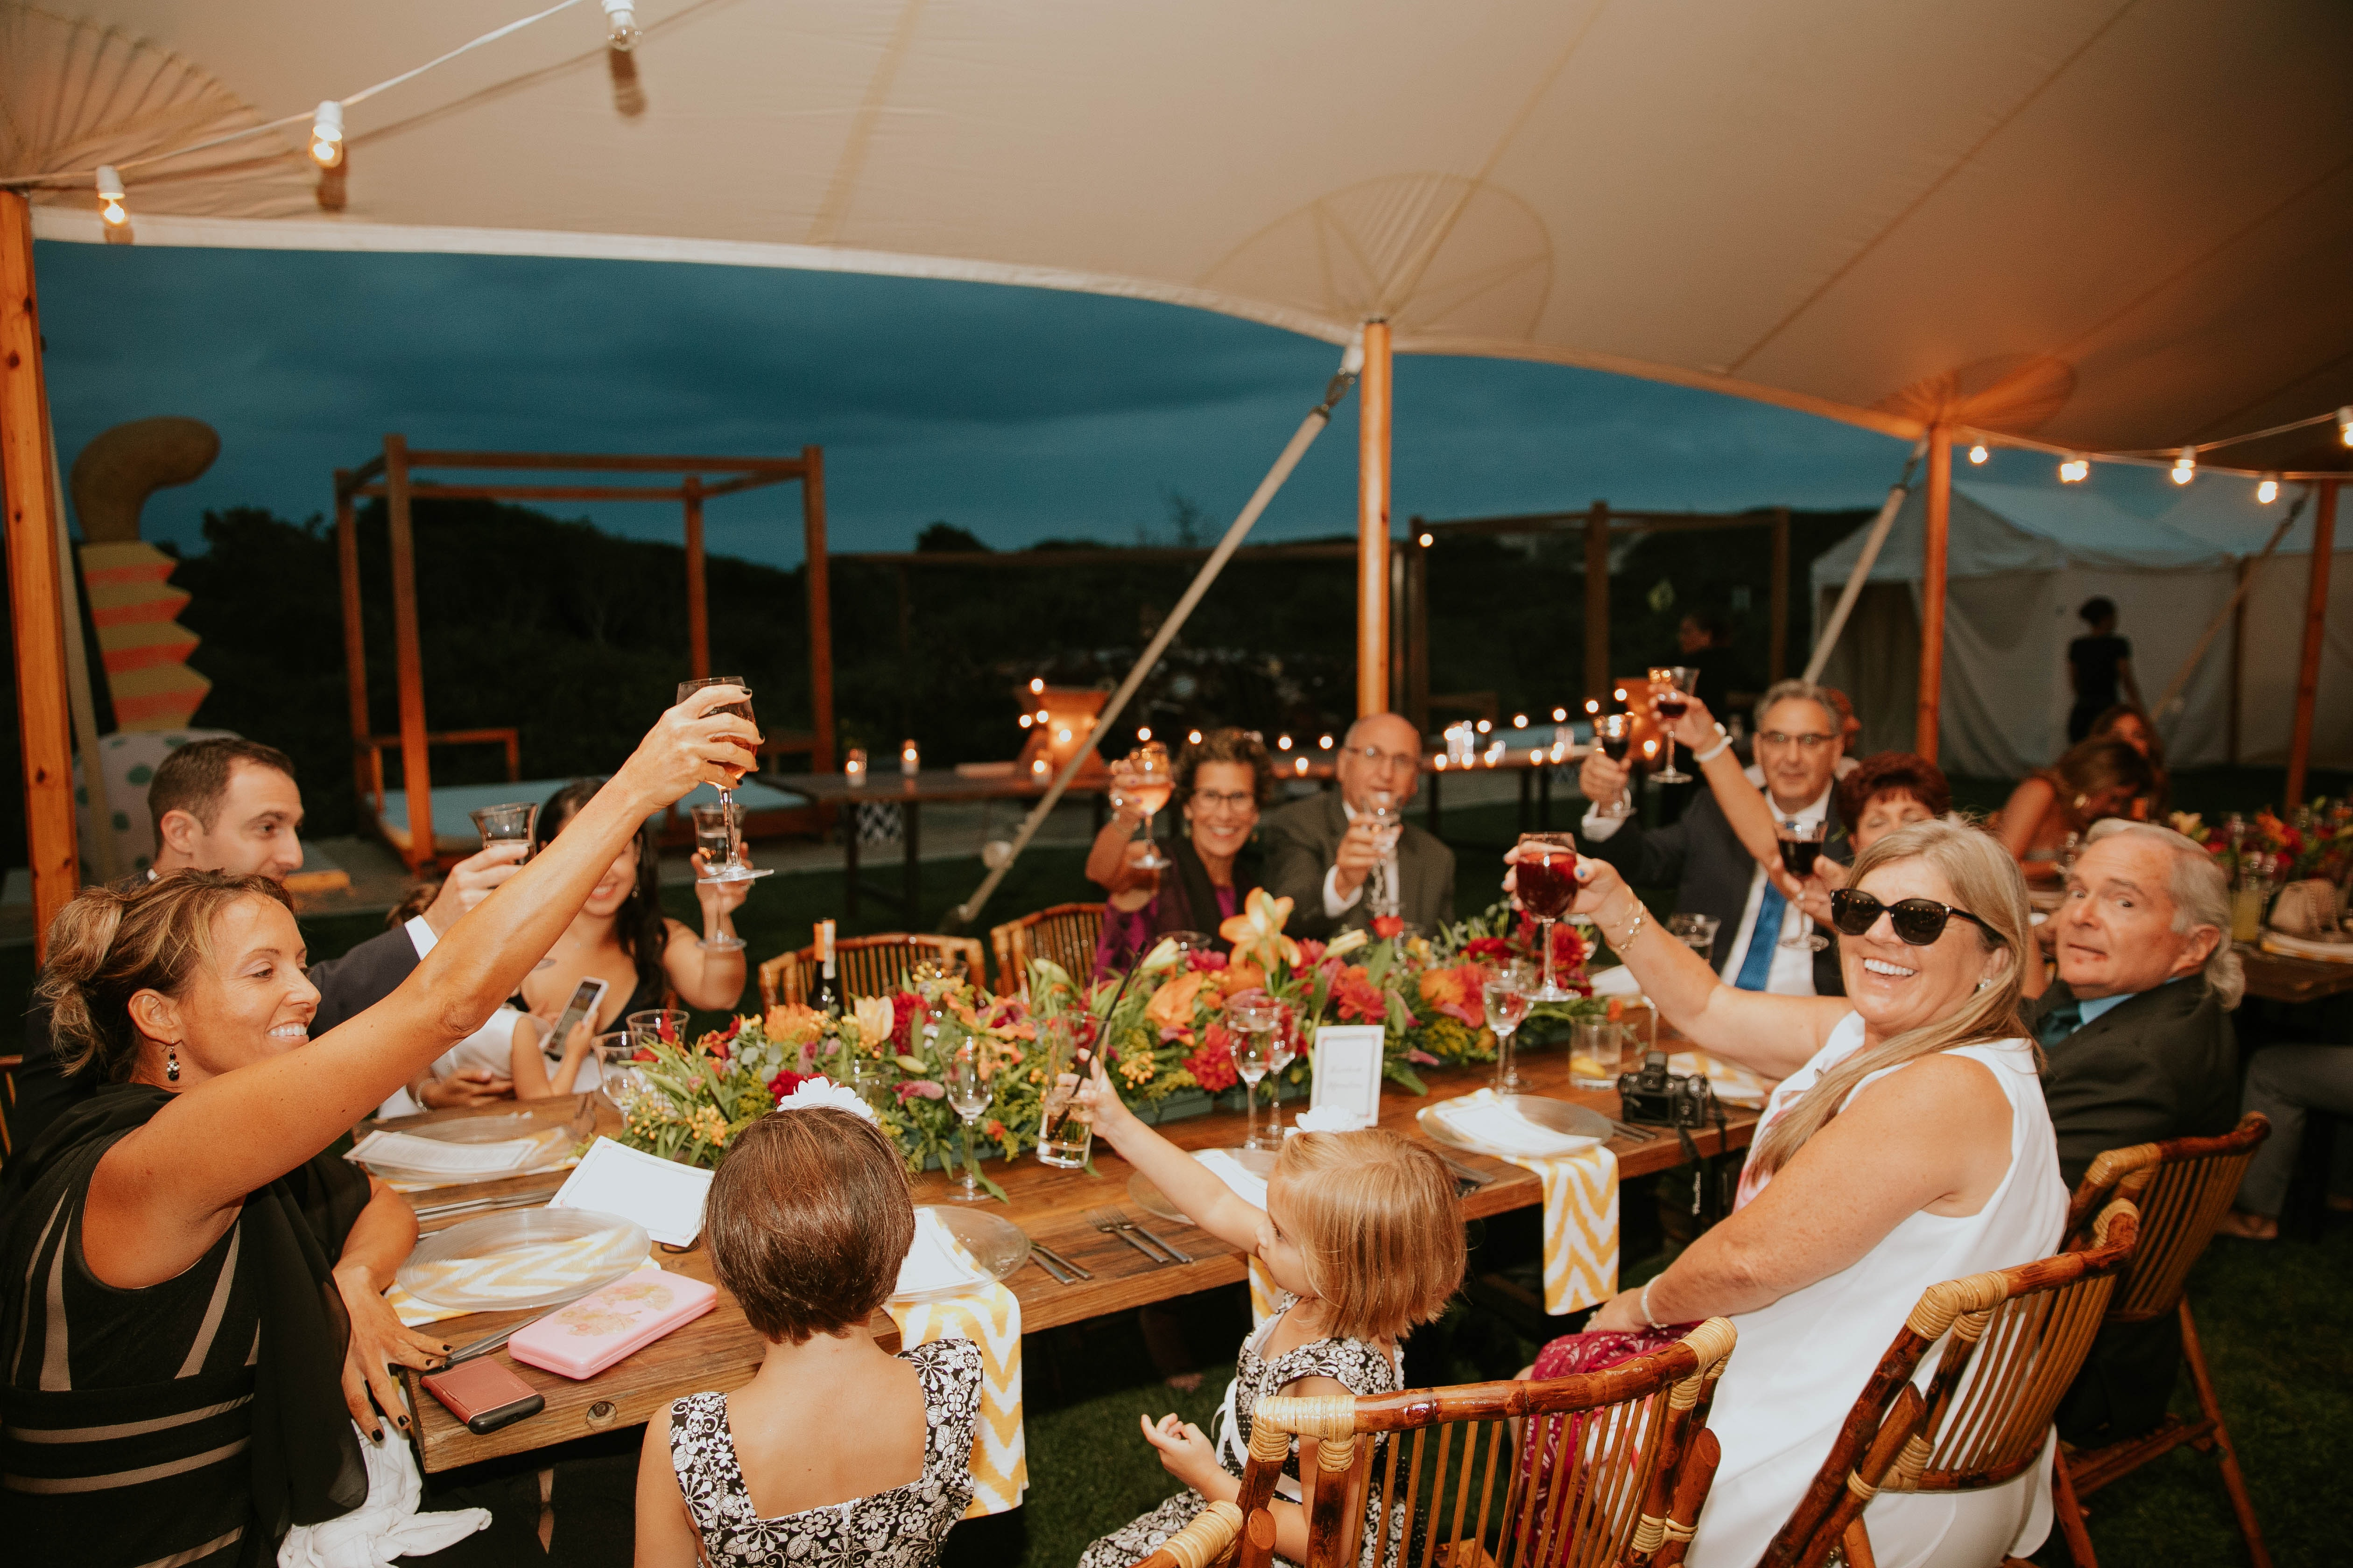
Family Vision Recognition Examples
Families Learning Together Build Generational Wealth

Slide 13
Chapter 14: Family Vision Rewards System
Family Vision Recognition Examples:
Educational Achievements
Financial Wealth Building Achievements
Real Estate Achievements
License Achievements
© 2020 Copyright by Generations Empowerment Enterprises, LLC
Notes:
Janice

Slide 14
Chapter 14: Family Vision Rewards System
Family Vision Recognition Examples:
Health & Fitness Achievements
Military Achievements
Spiritual/Religious Achievements
And more …
© 2020 Copyright by Generations Empowerment Enterprises, LLC
Notes:
Janice

Slide 15
Steps To Creating A Family Rewards System
Families Learning Together Build Generational Wealth

Slide 16
Chapter 14: Family Vision Rewards System
Steps to creating a family rewards system
Step 1: Written Family Vision Statement
Written Family Mission Statement
Written Objectives or Goals
Written Family Core Values
© 2020 Copyright by Generations Empowerment Enterprises, LLC
Notes:
Janice

Slide 17
Chapter 14: Family Vision Rewards System
Steps to creating a family rewards system
Step 2: Establish a Family Vision Rewards Program Committee
Step 3: Establish a Family Vision Rewards Program Budget
Step 4: Establish a written Family Vision Rewards Program
© 2020 Copyright by Generations Empowerment Enterprises, LLC
Notes:
Janice

Slide 18
Chapter 14: Family Vision Rewards System
Steps to creating a family rewards system
Step 5: Communicate it to your family
Step 6: Determine the frequency you will keep your family updated on the results (weekly, monthly, quarterly, etc.)
Step 6: Determine the method of communication (emails, private Facebook Group Page, text, etc.)
© 2020 Copyright by Generations Empowerment Enterprises, LLC
Notes:
Janice

Slide 19
Chapter 14: Family Vision Rewards System
Steps to creating a family rewards system
Step 8: Schedule your annual Family Vision Rewards Celebration or Banquet
Step 9: Create a list of family members and community influencers to invite
© 2020 Copyright by Generations Empowerment Enterprises, LLC
Notes:
Janice

Slide 20
Chapter 14: Family Vision Rewards System
Tips
Reward behavior that motivates family members; whose actions have moved the entire family closer towards achieving your family vision and mission.
Do not underestimate the power and long-term positive effects of sincerely recognizing and rewarding family members.
© 2020 Copyright by Generations Empowerment Enterprises, LLC
Notes:
Janice

Slide 21
Chapter 14: Family Vision Rewards System
Question
What is a good example of a formal family vision reward system?
© 2020 Copyright by Generations Empowerment Enterprises, LLC
Notes:
Janice

Slide 22
Chapter 14: Family Vision Rewards System
Assignment
WKB p.85
© 2020 Copyright by Generations Empowerment Enterprises, LLC
Notes:
Janice

Slide 23
Global Family Success Program A Generations Empowerment Enterprises, LLC Program

