Slide 1
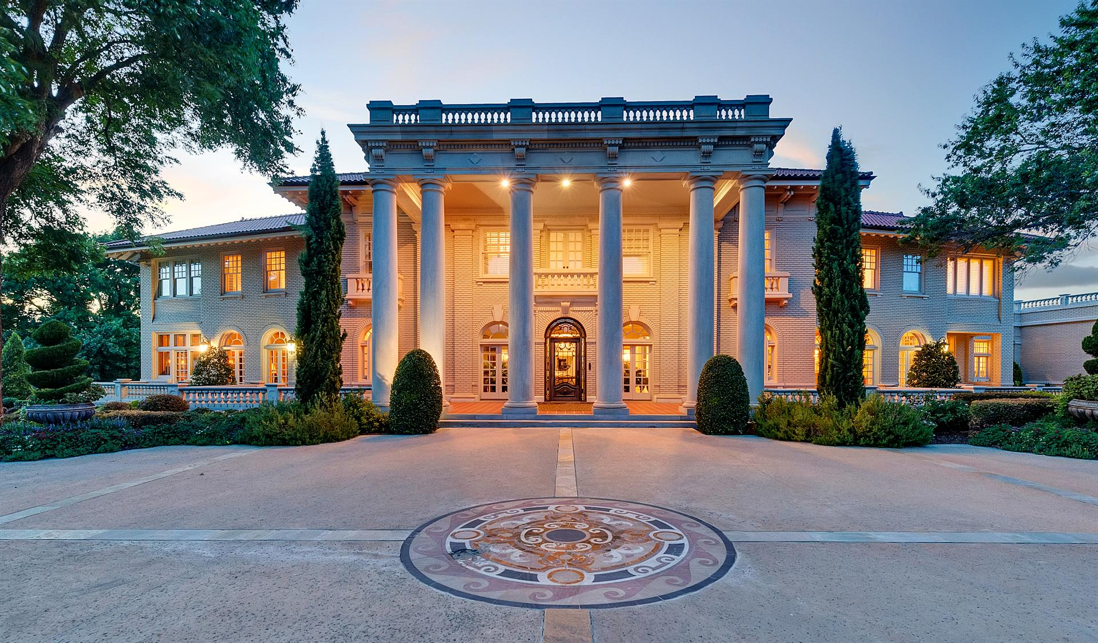
Generations Empowerment Enterprises, LLC Families Learning Together Build Generational Wealth

Slide 2
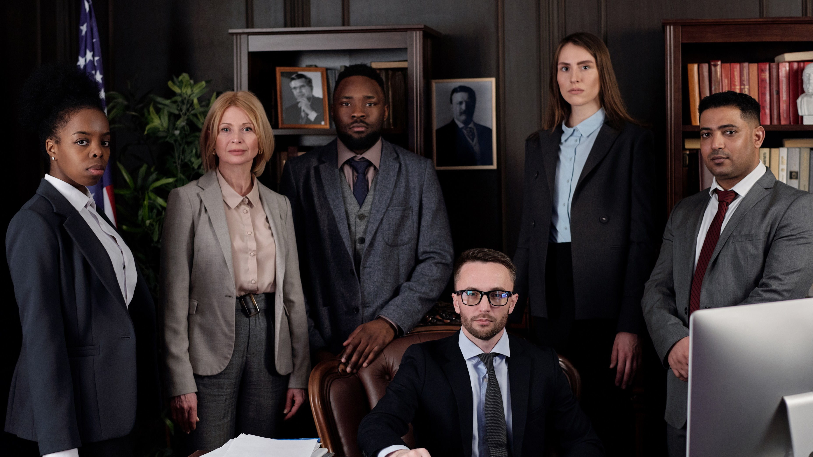
Mentors & Coaches Families Learning Together Build Generational Wealth

Slide 3
Chapter 25
Mentors & Coaches
© 2020 Copyright by Generations Empowerment Enterprises, LLC
Notes:
Janice

Slide 4
Chapter 25: Mentors & Coaches
“A mentor is someone who allows you to see hope inside yourself.”
By Oprah Winfrey
© 2020 Copyright by Generations Empowerment Enterprises, LLC
Notes:
Janice – Explain Parking Lot
Pause to allow time for the Family Vision Poll – use small white piece of paper – Everyone participate
Questions: If you have a question, raise your hand. We welcome questions anytime. Or put on the Parking Lot.
Explain the Parking Lot – purpose
Pause NOW to give everyone a few minutes to complete their POLL – Everyone will need a small piece of the white pre-cut paper. Here's the questions:
Do you have a Written Family Vision? Answer only YES or NO - We do NOT need your names. This is for a later activity. THANK YOU!
Allow time for participants to complete the Family Vision Poll & Collect Now!!!
Note: During this workshop you will learn both the “DO’s and DONT’s” associated with family success. The don’ts are just as important as the do’s.

Slide 5
Chapter 25: Mentors & Coaches
Objectives:
Learn the characteristics you should look for when selecting a mentor or family leadership coach
© 2020 Copyright by Generations Empowerment Enterprises, LLC
Notes:
Janice

Slide 6
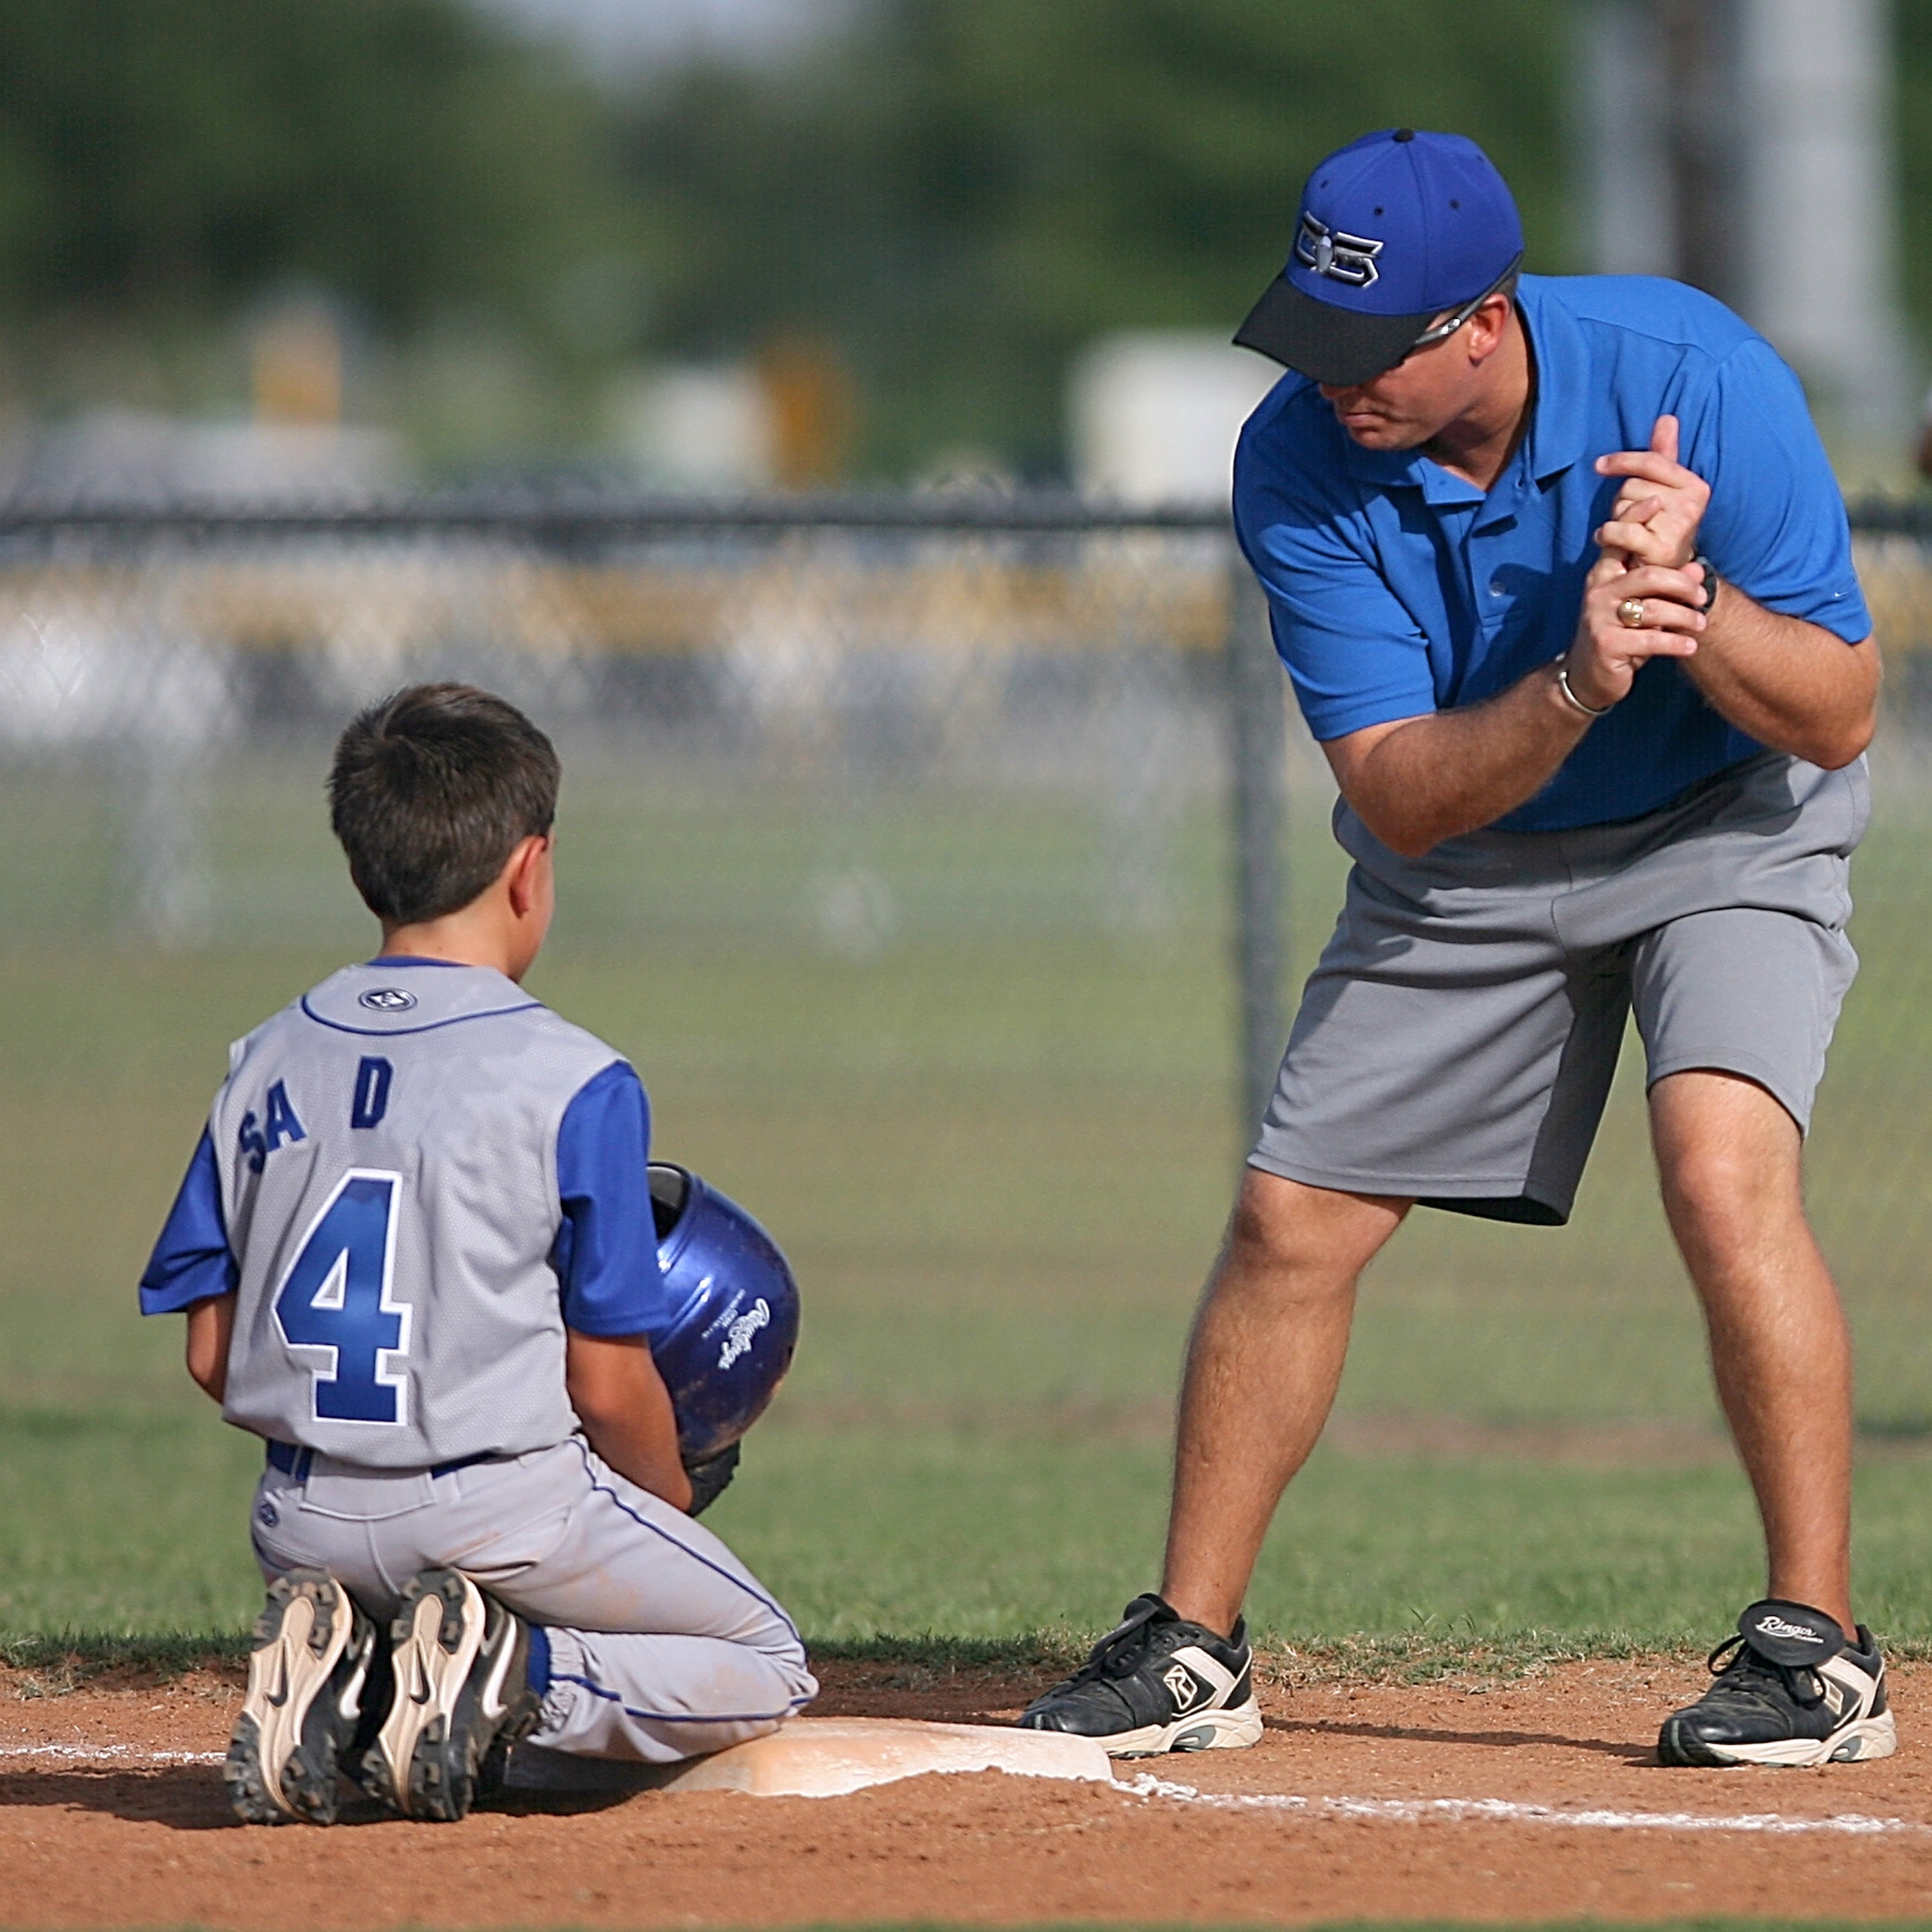
Seven (7) Types of Mentors

Slide 7
Chapter 25: Mentors & Coaches
Seven (7) Types of Mentors:
Acronym “MENTORS”
M = Motivational Mentors
E = Expert Mentors
N = Networking Mentors
T = Talented Mentors
© 2020 Copyright by Generations Empowerment Enterprises, LLC
Notes:
Janice

Slide 8
Chapter 25: Mentors & Coaches
Assignment
© 2020 Copyright by Generations Empowerment Enterprises, LLC
Notes:
Janice

Slide 9
Mentors & Coaches Families Learning Together Build Generational Wealth

Slide 10
Generations Empowerment Enterprises, LLC Families Learning Together Build Generational Wealth

