Slide 1
Global Family Success Program A Generations Empowerment Enterprises, LLC Program

Slide 2
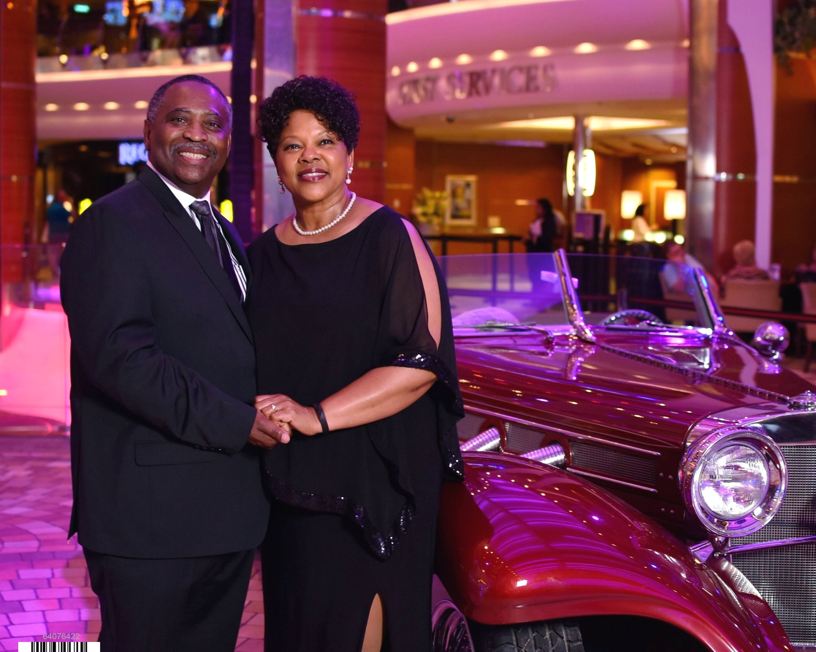
Our Multigenerational Lifestyle Story: The Porter Family

Slide 3
Chapter 18: Boomerang Flight Plan to Debt Freedom & Wealth
Our Multigenerational Lifestyle Story
Family Vision
Goals
Achievements
© 2020 Copyright by Generations Empowerment Enterprises, LLC
Notes:
Janice

Slide 4
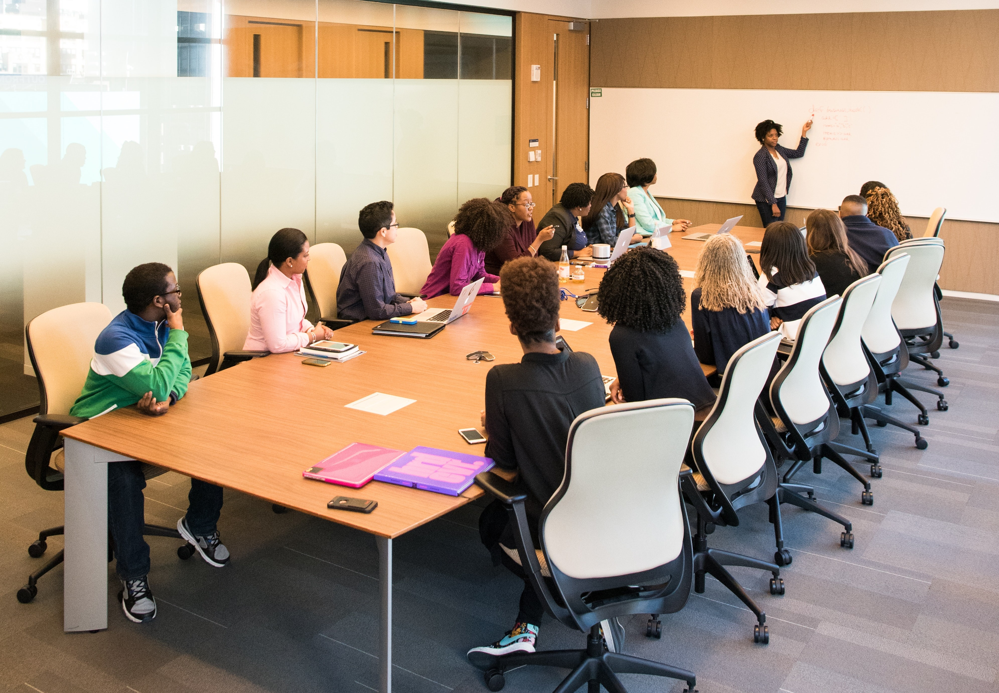
Family Empowerment Services
Family Success
Webinars
Family Private Weekend Retreats
Group Webinars & Workshops
Coaching
Services
© 2020 Copyright by Generations Empowerment Enterprises, LLC
Notes:
Phillip or Janice

Slide 5
Contact
Email: admin@globalfamilysuccess.com
Website: https://globalfamilysuccess.com
Facebook: https://www.facebook.com/GenerationsEmpowermentEnterprisesLLC
© 2020 Copyright by Generations Empowerment Enterprises, LLC
Notes:
Phillip or Janice

Slide 6
Global Family Success Program A Generations Empowerment Enterprises, LLC Program

