Slide 1
Generations Empowerment Enterprises, LLC Families Learning Together Build Generational Wealth

Slide 2
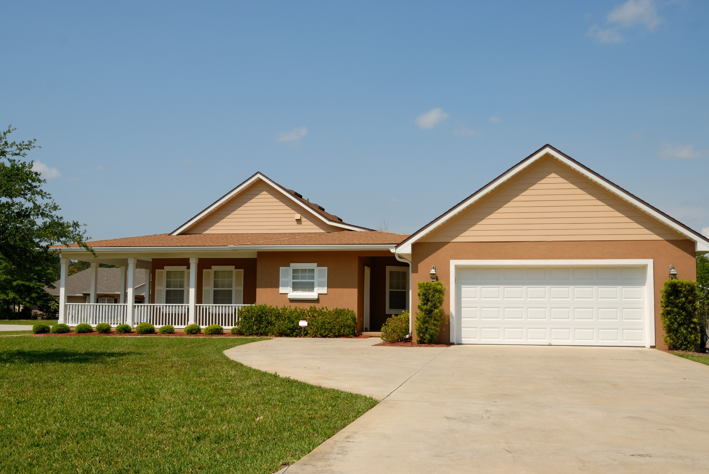
Benefits of Owning Income Producing Property Families Learning Together Build Generational Wealth

Slide 3
Chapter 21: Real Estate Ownership
The Benefits of Owning Income Producing Property:
Acronym DRIFTS
D = Decision Maker
R = Real Estate Appreciation
I = Inflation
© 2020 Copyright by Generations Empowerment Enterprises, LLC
Notes:
Janice

Slide 4
Chapter 21: Real Estate Ownership
The Benefits of Owning Income Producing Property:
Acronym DRIFTS
F = Financial Security
T = Tax Benefits
S = Steady Income
© 2020 Copyright by Generations Empowerment Enterprises, LLC
Notes:
Janice

Slide 5
Chapter 21: Real Estate Ownership
“The best investment on Earth is earth.”
By Louis Glickman
© 2020 Copyright by Generations Empowerment Enterprises, LLC
Notes:
Janice – Explain Parking Lot
Pause to allow time for the Family Vision Poll – use small white piece of paper – Everyone participate
Questions: If you have a question, raise your hand. We welcome questions anytime. Or put on the Parking Lot.
Explain the Parking Lot – purpose
Pause NOW to give everyone a few minutes to complete their POLL – Everyone will need a small piece of the white pre-cut paper. Here's the questions:
Do you have a Written Family Vision? Answer only YES or NO - We do NOT need your names. This is for a later activity. THANK YOU!
Allow time for participants to complete the Family Vision Poll & Collect Now!!!
Note: During this workshop you will learn both the “DO’s and DONT’s” associated with family success. The don’ts are just as important as the do’s.

Slide 6
Chapter 21: Real Estate Ownership
Assignment
WKB p.126
© 2020 Copyright by Generations Empowerment Enterprises, LLC
Notes:
Janice

Slide 7
Generations Empowerment Enterprises, LLC Families Learning Together Build Generational Wealth

