Slide 1
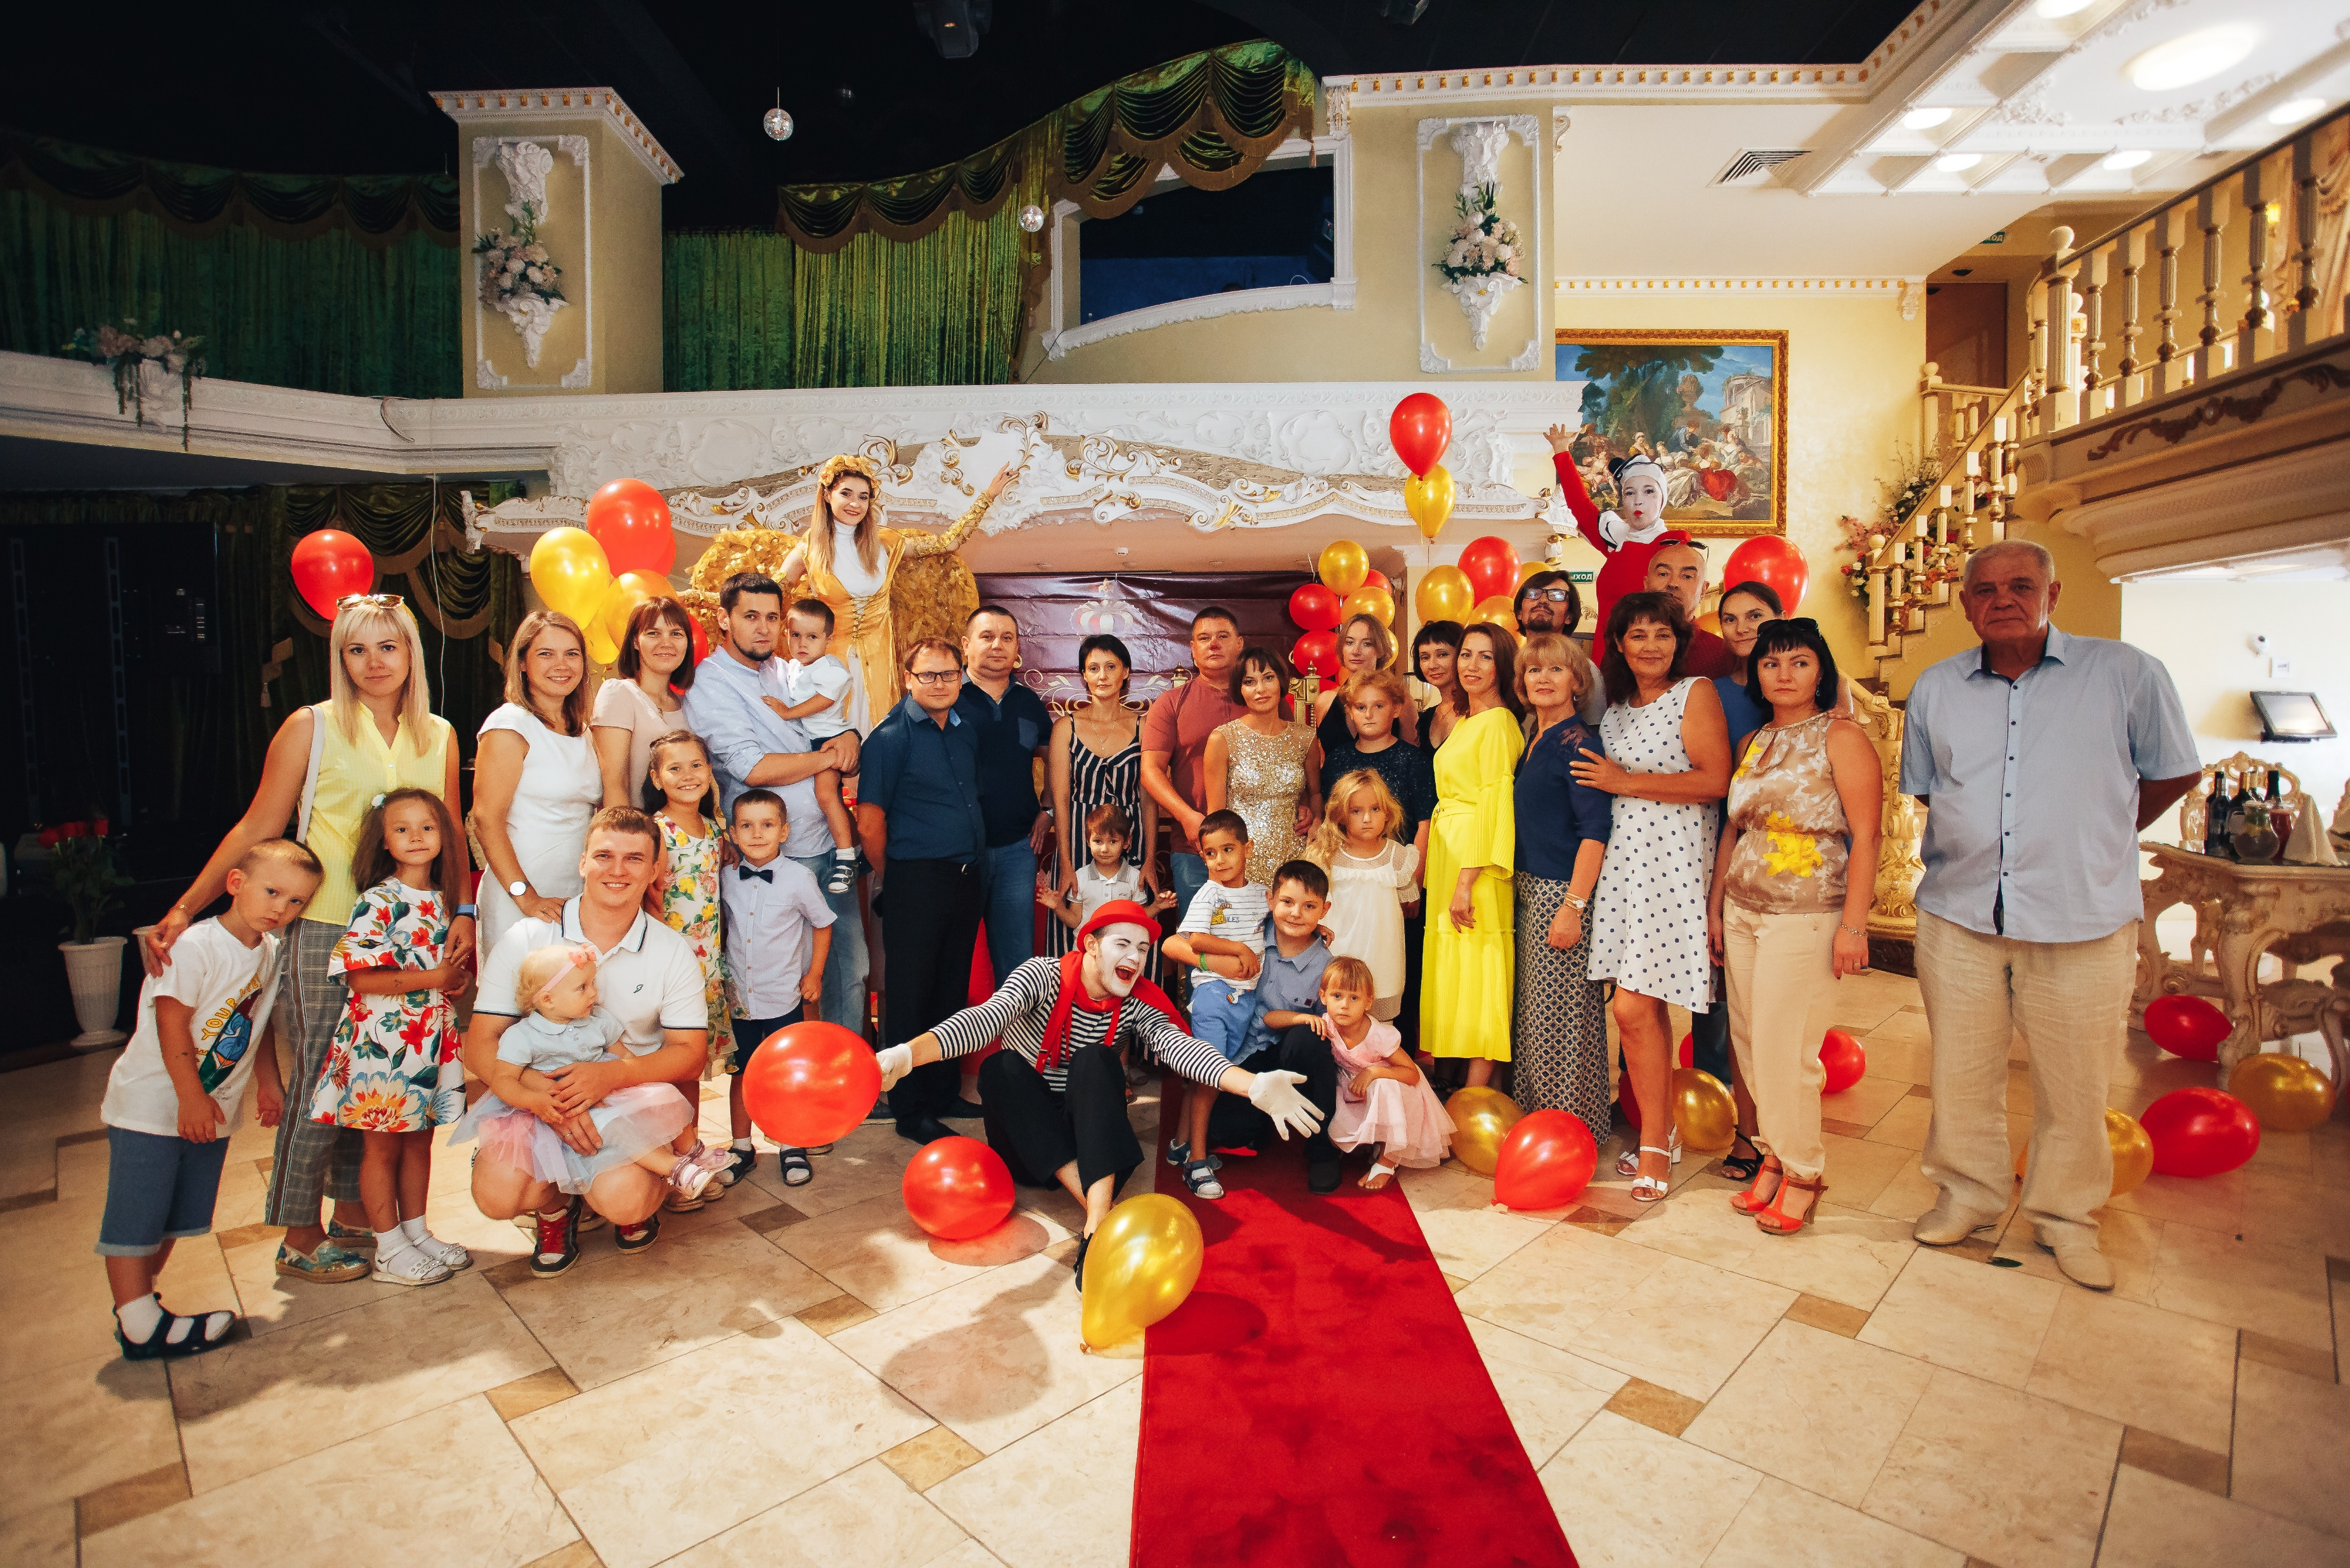

10 Steps To Creating A Family Vision Rewards System
Families Learning Together Build Generational Wealth

Slide 2
Chapter 14: Family Vision Rewards System
10 Steps to creating a family vision rewards system
Step 1: Written Family Vision Statement
Written Family Mission Statement
Written Objectives or Goals
Written Family Core Values
© 2020 Copyright by Generations Empowerment Enterprises, LLC
Notes:
Janice

Slide 3
Chapter 14: Family Vision Rewards System
10 Steps to creating a family vision rewards system
Step 2: Establish a Family Vision Rewards Program Committee
Step 3: Establish a Family Vision Rewards Program Budget
Step 4: Establish a written Family Vision Rewards Program Criteria and prizes/awards
© 2020 Copyright by Generations Empowerment Enterprises, LLC
Notes:
Janice

Slide 4
Chapter 14: Family Vision Rewards System
10 Steps to creating a family vision rewards system
Step 5: Communicate it to your family
Step 6: Determine the method of communication (emails, private Facebook Group Page, text, etc.)
Step 7: Determine the frequency you will keep your family updated on the results (weekly, monthly, quarterly, etc.)
© 2020 Copyright by Generations Empowerment Enterprises, LLC
Notes:
Janice

Slide 5
Chapter 14: Family Vision Rewards System
10 Steps to creating a family vision rewards system
Step 8: Schedule your annual Family Vision Rewards Celebration or Banquet
Step 9: Create a list of family members and community influencers to invite
Step 10: Record the Family Vision Rewards Celebration
© 2020 Copyright by Generations Empowerment Enterprises, LLC
Notes:
Janice

Slide 6
Chapter 14: Family Vision Rewards System
Tips
Reward behavior that motivates family members; whose actions have moved the entire family closer towards achieving your family vision and mission.
Do not underestimate the power and long-term positive effects of sincerely recognizing and rewarding family members.
© 2020 Copyright by Generations Empowerment Enterprises, LLC
Notes:
Janice

Slide 7
10 Steps To Creating A Family Vision Rewards System
Families Learning Together Build Generational Wealth

