Slide 1
Two Visual Representations of Your Family History

Slide 2
Chapter 4: Family History
Two Visual Representations of Your Family History
Family Milestones Timeline
Family Tree
© 2020 Copyright by Generations Empowerment Enterprises, LLC
Notes:
Janice

Slide 3
Chapter 4: Family History
Family Milestones Timeline
Milestones Timeline: Per Merriam Webster Dictionary, a milestone is a stone by the side of a road that shows the distance in miles to a specified place, or an important point in the progress or development of something (family): a very important event or advance
© 2020 Copyright by Generations Empowerment Enterprises, LLC
Notes:
Janice – Here’s another ex of how to document your family history – using a Family Tree Model.

Slide 4
Chapter 4: Family History
Family Milestone Timeline
© 2020 Copyright by Generations Empowerment Enterprises, LLC
Notes:
Janice – here’s an example of how you can write it down….NOTE you do not have to be fancy the key is to write it down. & Share it with your Family

Slide 5
Chapter 4: Family History
Family Tree
A family tree is a diagram showing the relationships between people in several generations of the family; a genealogical tree. Create a family tree and share with your family
© 2020 Copyright by Generations Empowerment Enterprises, LLC
Notes:
Janice – Here’s another ex of how to document your family history – using a Family Tree Model.

Slide 6
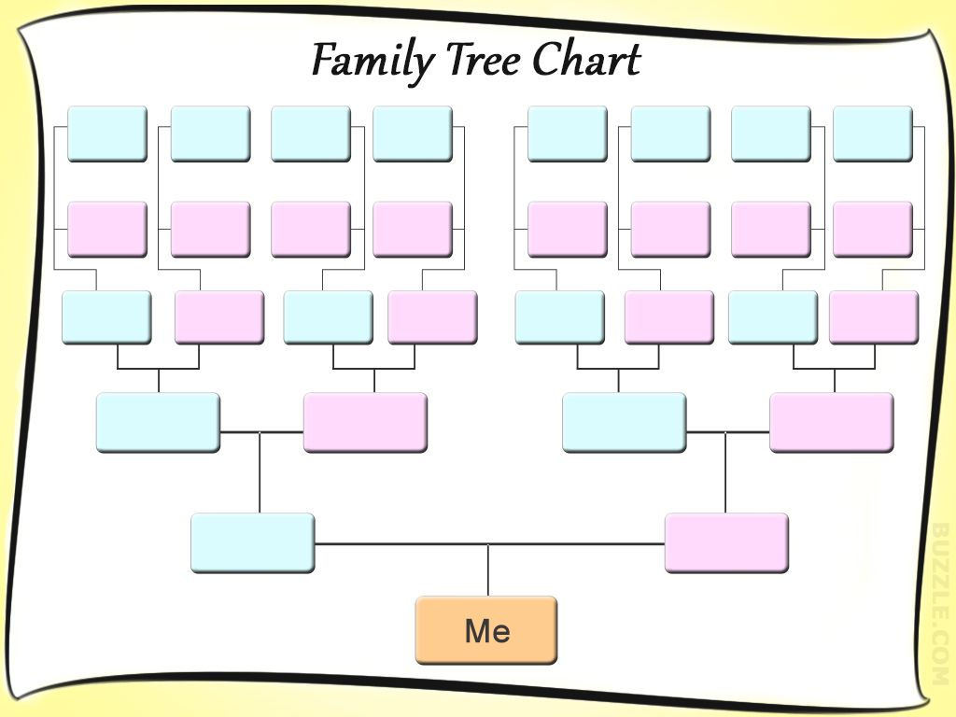
Chapter 4: Family History
Family Tree
© 2020 Copyright by Generations Empowerment Enterprises, LLC
Notes:
Janice – Here’s another ex of how to document your family history – using a Family Tree Model.

Slide 7
Two Visual Representations of Your Family History

